Slide 1
Evaluating ECAL timing properties using test beam data and Machine Learning
Student: Fakanov Pavel
Supervisor: Ratnikov Fedor

Slide 2
Introduction
Dominique Breton in his presentation “A few thoughts about measuring time with the new ECAL of LHCb“
We want to apply Machine Learning to process impulse signals coming from ECAL detector
Now a signal is sampled with frequency = 5000 MHz, so it’s really a LOT OF DATA!
We would like to decrease sampling frequency, but we want to predict reference time of a signal as precisely as before or even better
The goal is not to improve particular baseline algorithm with ML
The goal is to use ML to extract the maximum of available in data information and evaluate limitations of the possible physics performance that are driven by behaviours of actual, test beam data

Slide 3
A few words about data
Data obtained from the 30 GeV electron beam
Use “output” module of the LHCb electromagnetic calorimeter
Reference time is measured as average of two quick scintillator counters
5GHz sampling rate

Slide 4
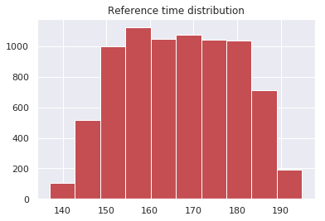
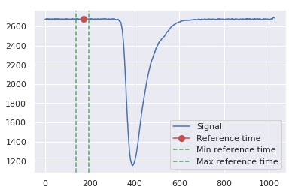
Problem 1. Predict reference time for a signal

Slide 5
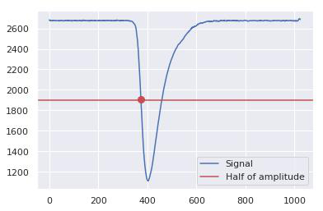
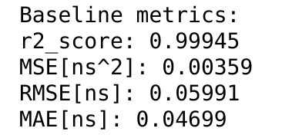
Baseline method description

Slide 6
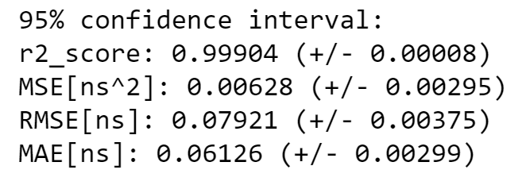
Linear regression out of the box
Let’s try to beat baseline score by adding polynomial features to our model, but at first let’s try to reduce the dimension of our samples

Slide 7
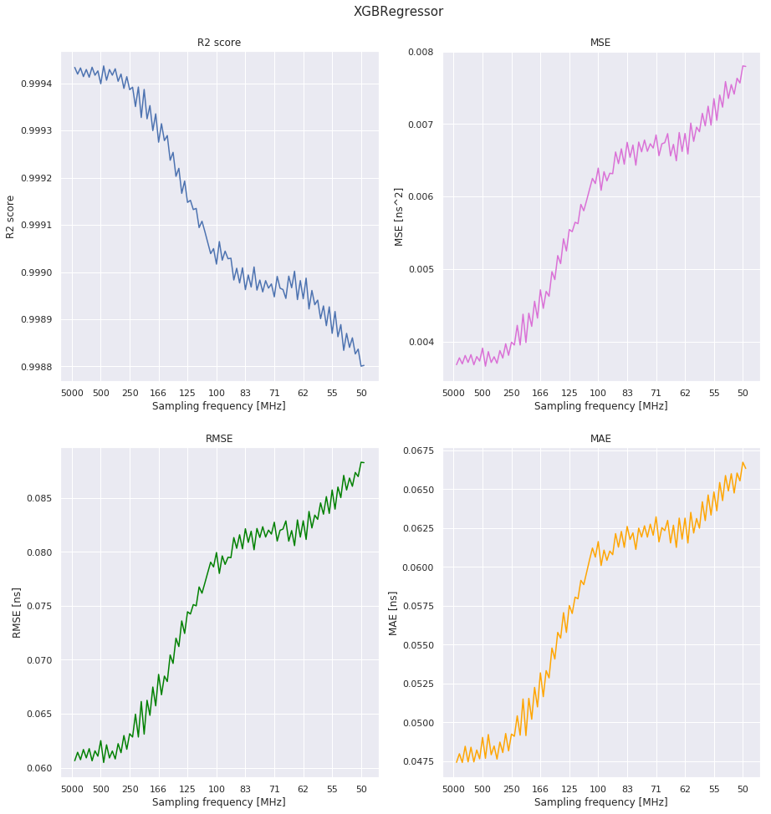
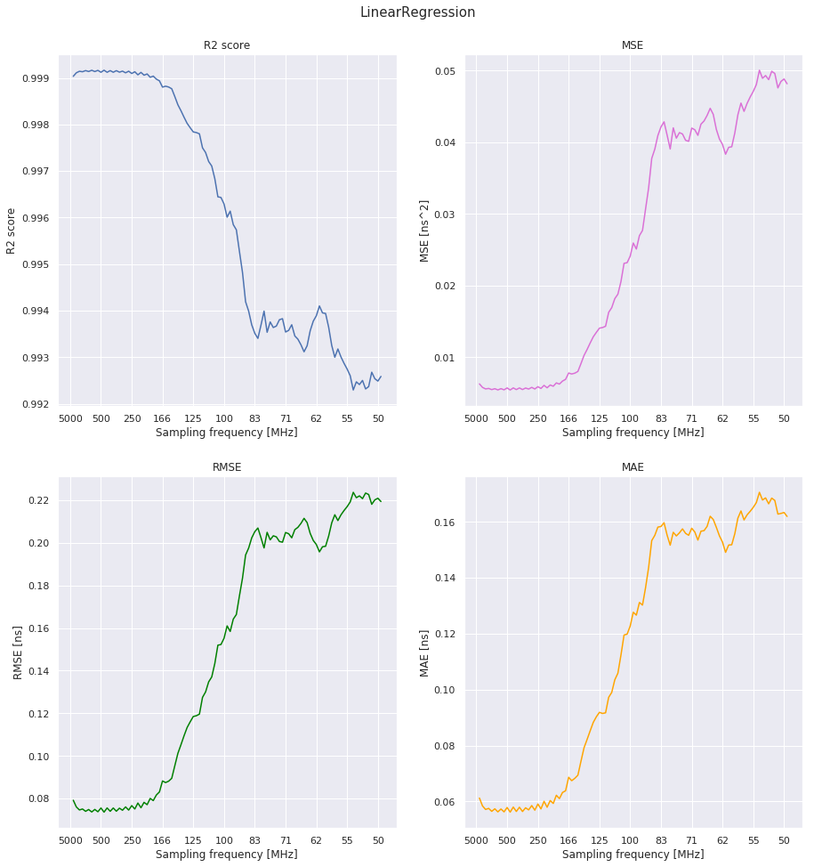
Scores dependency on sampling frequency

Slide 8
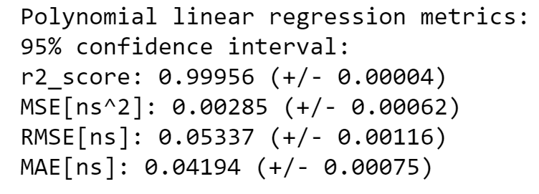
Linear regression with polynomial features
We can reduce the sampling frequency by 15 times!!!

Slide 9
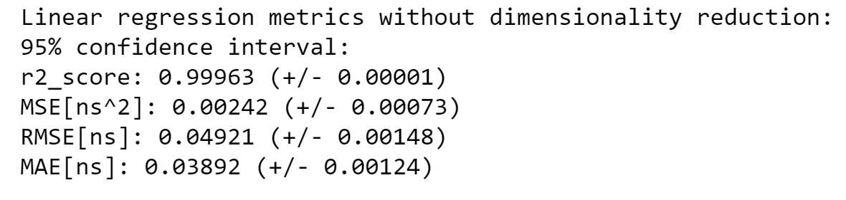
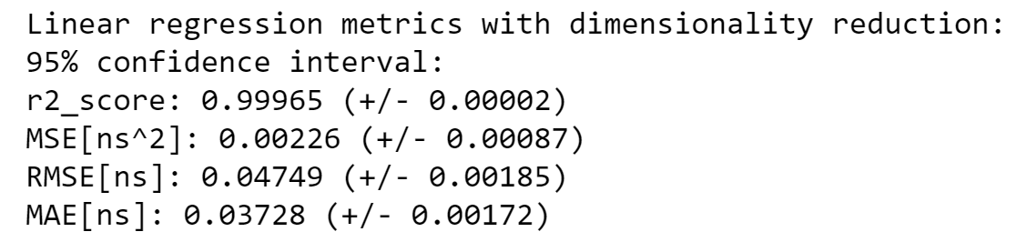
Data preprocessing does matter

Slide 10
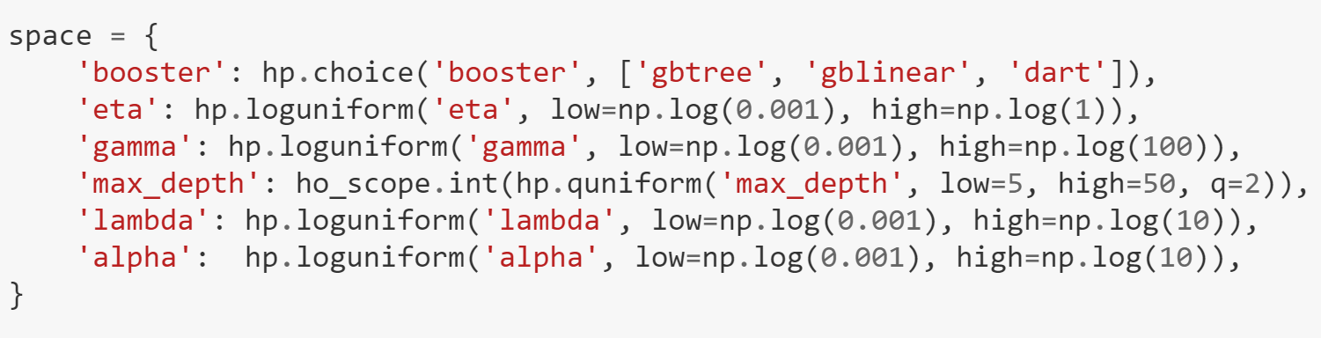
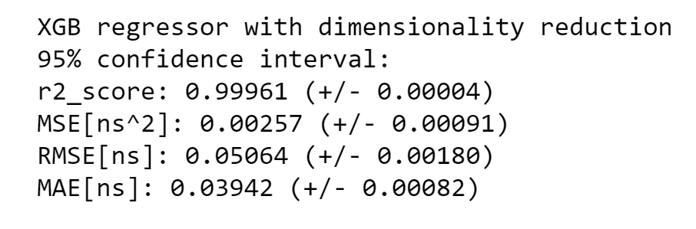
Model tuning

Slide 11
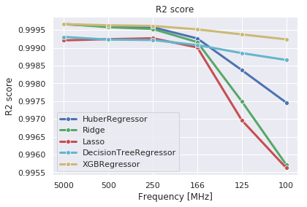
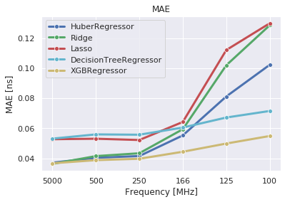
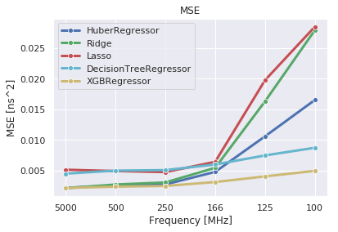
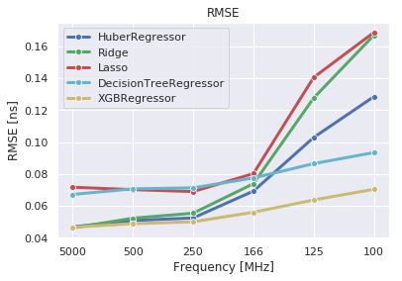
Models comparison

Slide 12
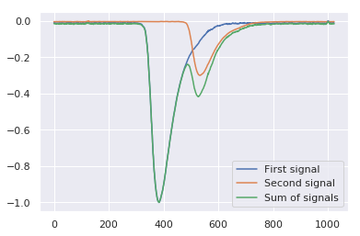
What if there are two signals?

Slide 13
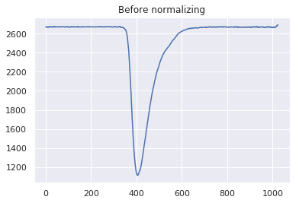
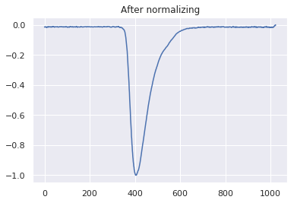
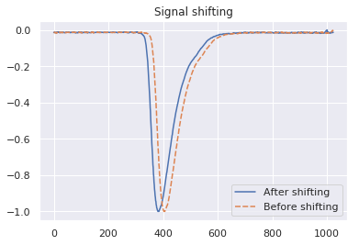
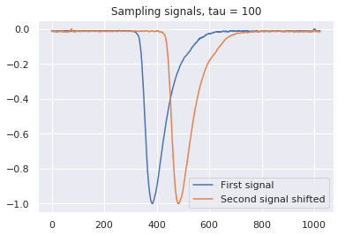
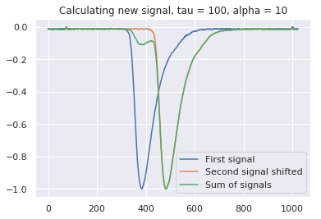
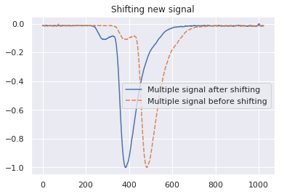
A few words about data preparation

Slide 14
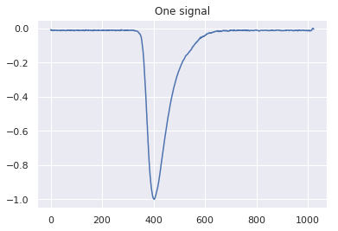
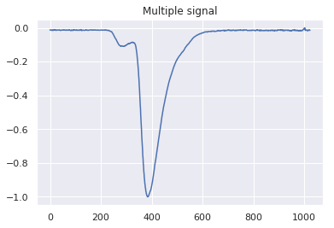
Problem 2
Predict if there is one signal or there are two signals

Slide 15
Problem 2
Used models

Slide 16
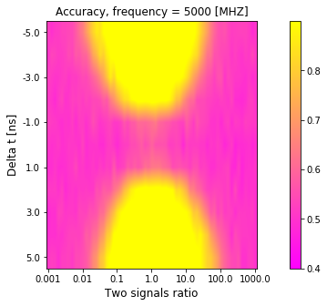
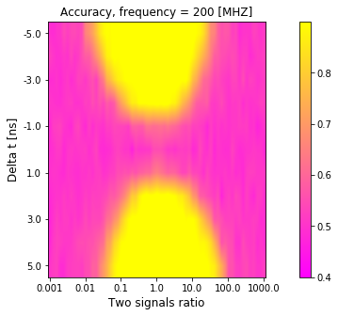
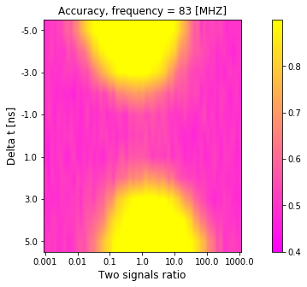
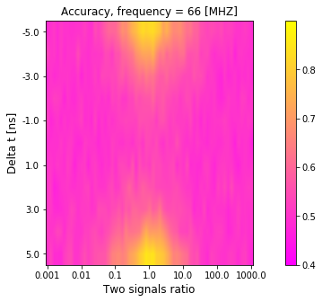
Problem 2. Results

Slide 17
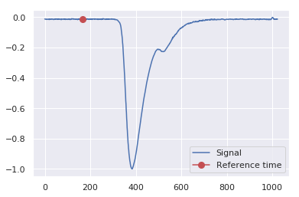
Problem 3
Predict the reference time of a multiple signal

Slide 18
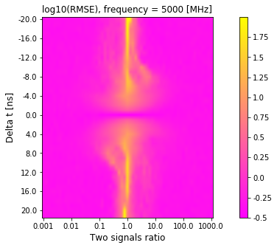
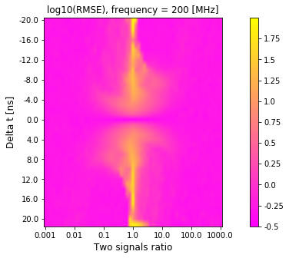
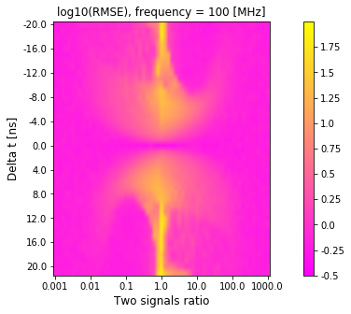
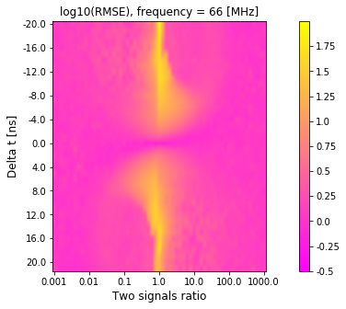
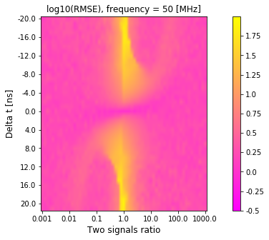
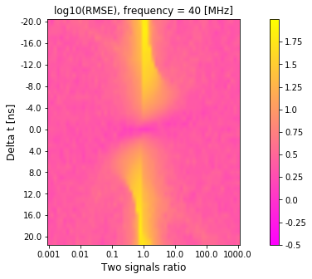
Problem 3. Results

Slide 19
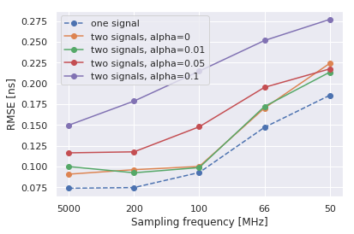
Comparing the scores of a model for one signal and a model for two signals

Slide 20
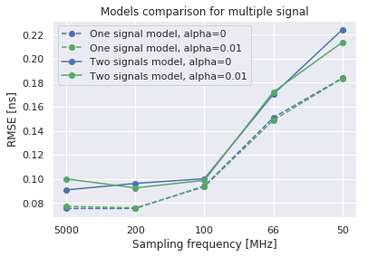
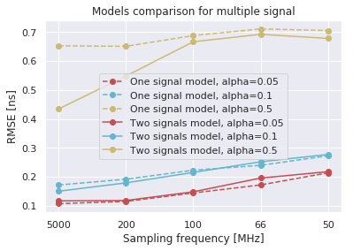
What if we use a model for one signal to predict a multiple signal?

Slide 21
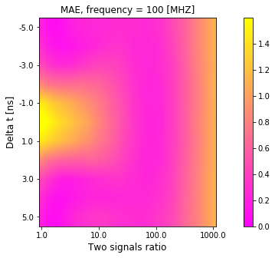
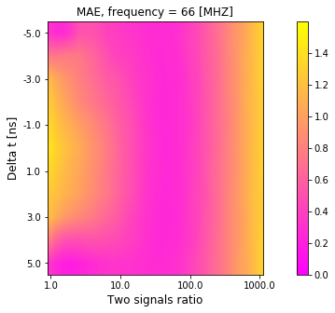
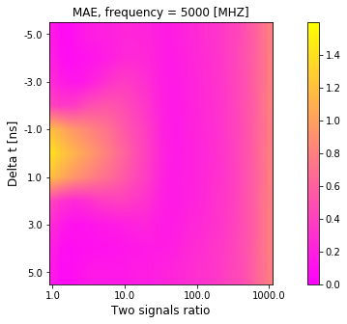
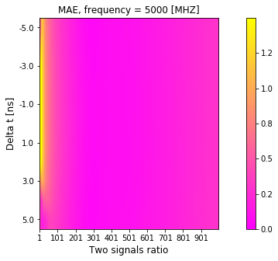
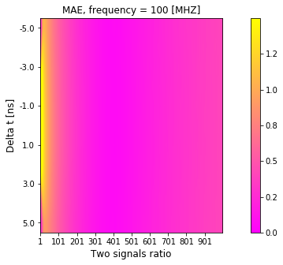
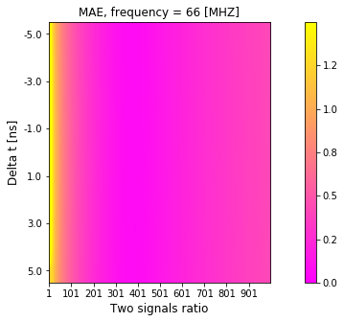
Problem 4. Let’s try to extract alpha from a multiple signal
Log train distribution
Uniform train distribution

Slide 22
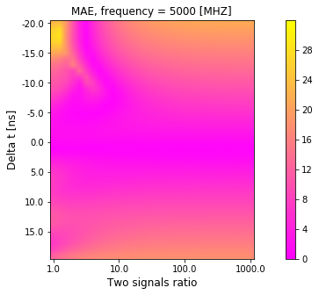
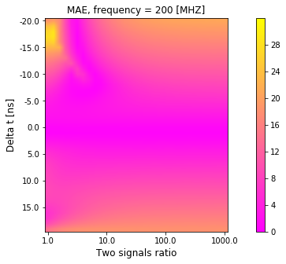
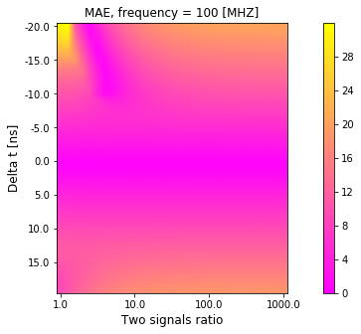
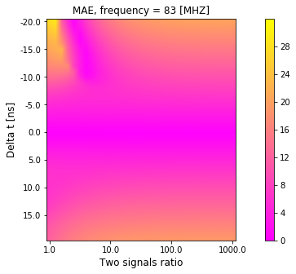
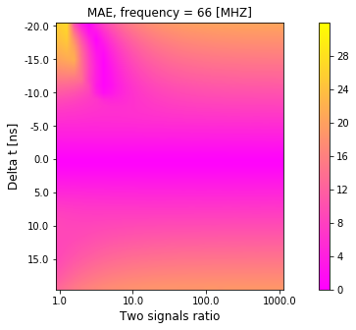

Problem 5. Let’s try to extract tau from a multiple signal

Slide 23
Conclusions
Using non-parametric ML approaches allows comprehensive evaluation of different properties from different perspectives
Using signals obtained in test beam measurements we estimated
Effect of signal sampling rate on the timing resolution
Efficiency to identify presence of another particle in the signal
Disturbing of time measurements due to another particle contribution in the signal
Obtained results may be plugged into the physics simulation to evaluate effects of higher occupancies on ECAL reconstruction

